Slide 1
food information system
Fuzzy logic project
Students name:Mohammad alshahrour
dr:tarek barhoum

Slide 2
scope of the project
it’s a fuzzy logic project that takes daily user’s nutrition values as input
and compare it with universal nutrition values
then gives a report of user’s nutrition information as a crisp value of (0-10)
which will be explained later .

Slide 3
inputs of the system
as mentioned the system has 5 inputs which are :
1.amount of water that the user had in the day .
2.amount of carbohydrates.
3.amount of iron .
4.amount of vitamin.
5.amount of protein.

Slide 4
the output and the range of
the output will be a single crisp value from 5 evaluations of user’s nutrition system .
(0-2) is extremely bad.
(2-4) is very bad .
(4-6) is bad .
(6-8) is good.
(8-10) is very good.

Slide 5
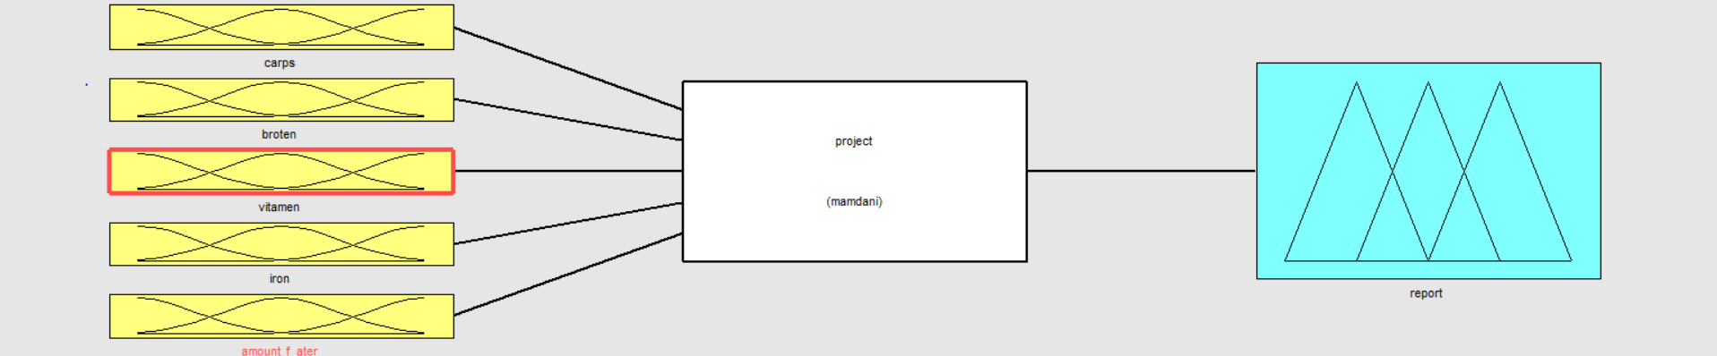
fuzzy system inputs and outputs:
5 INPUTS:
1 output

Slide 6
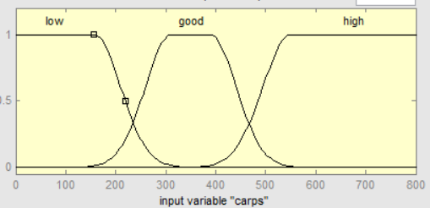
range of carbs values and it’s evaluation as the universal organizations

Slide 7
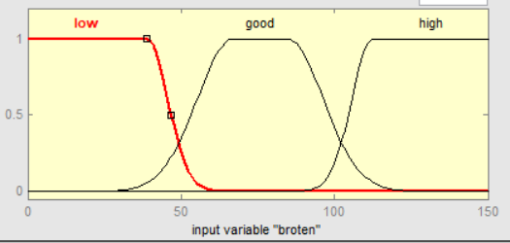
range of protein values and it’s evaluation as the universal organizations

Slide 8
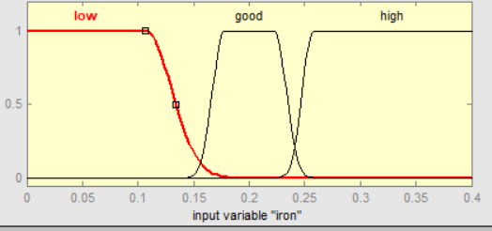
range of iron values and it’s evaluation as the universal organizations

Slide 9
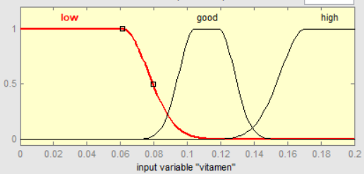
range of vitamin values and it’s evaluation as the universal organizations

Slide 10
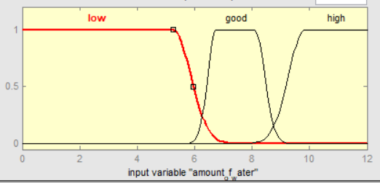
range of water amounts

Slide 11
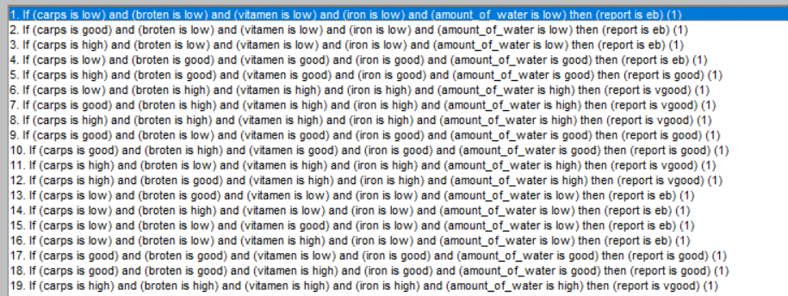
system rules

Slide 12
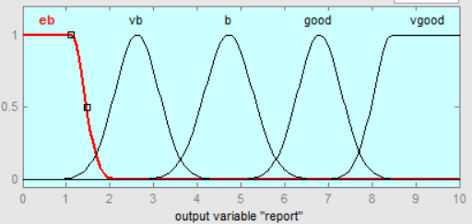
system work
after we have the inputs and match the rule with it the fuzzy system will process it and give the output as a crisp value

Slide 13
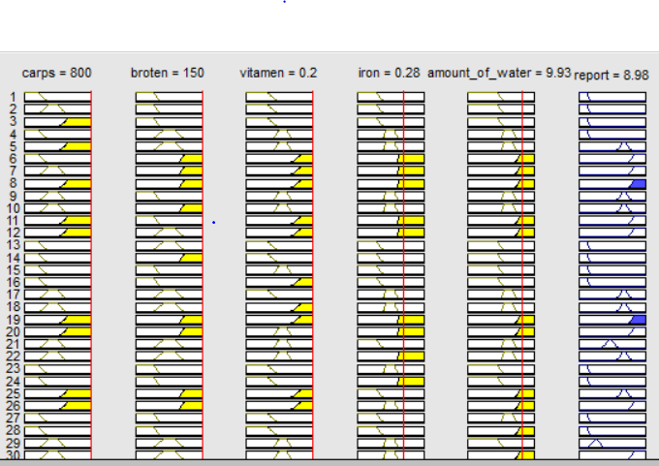
final test :

Slide 14
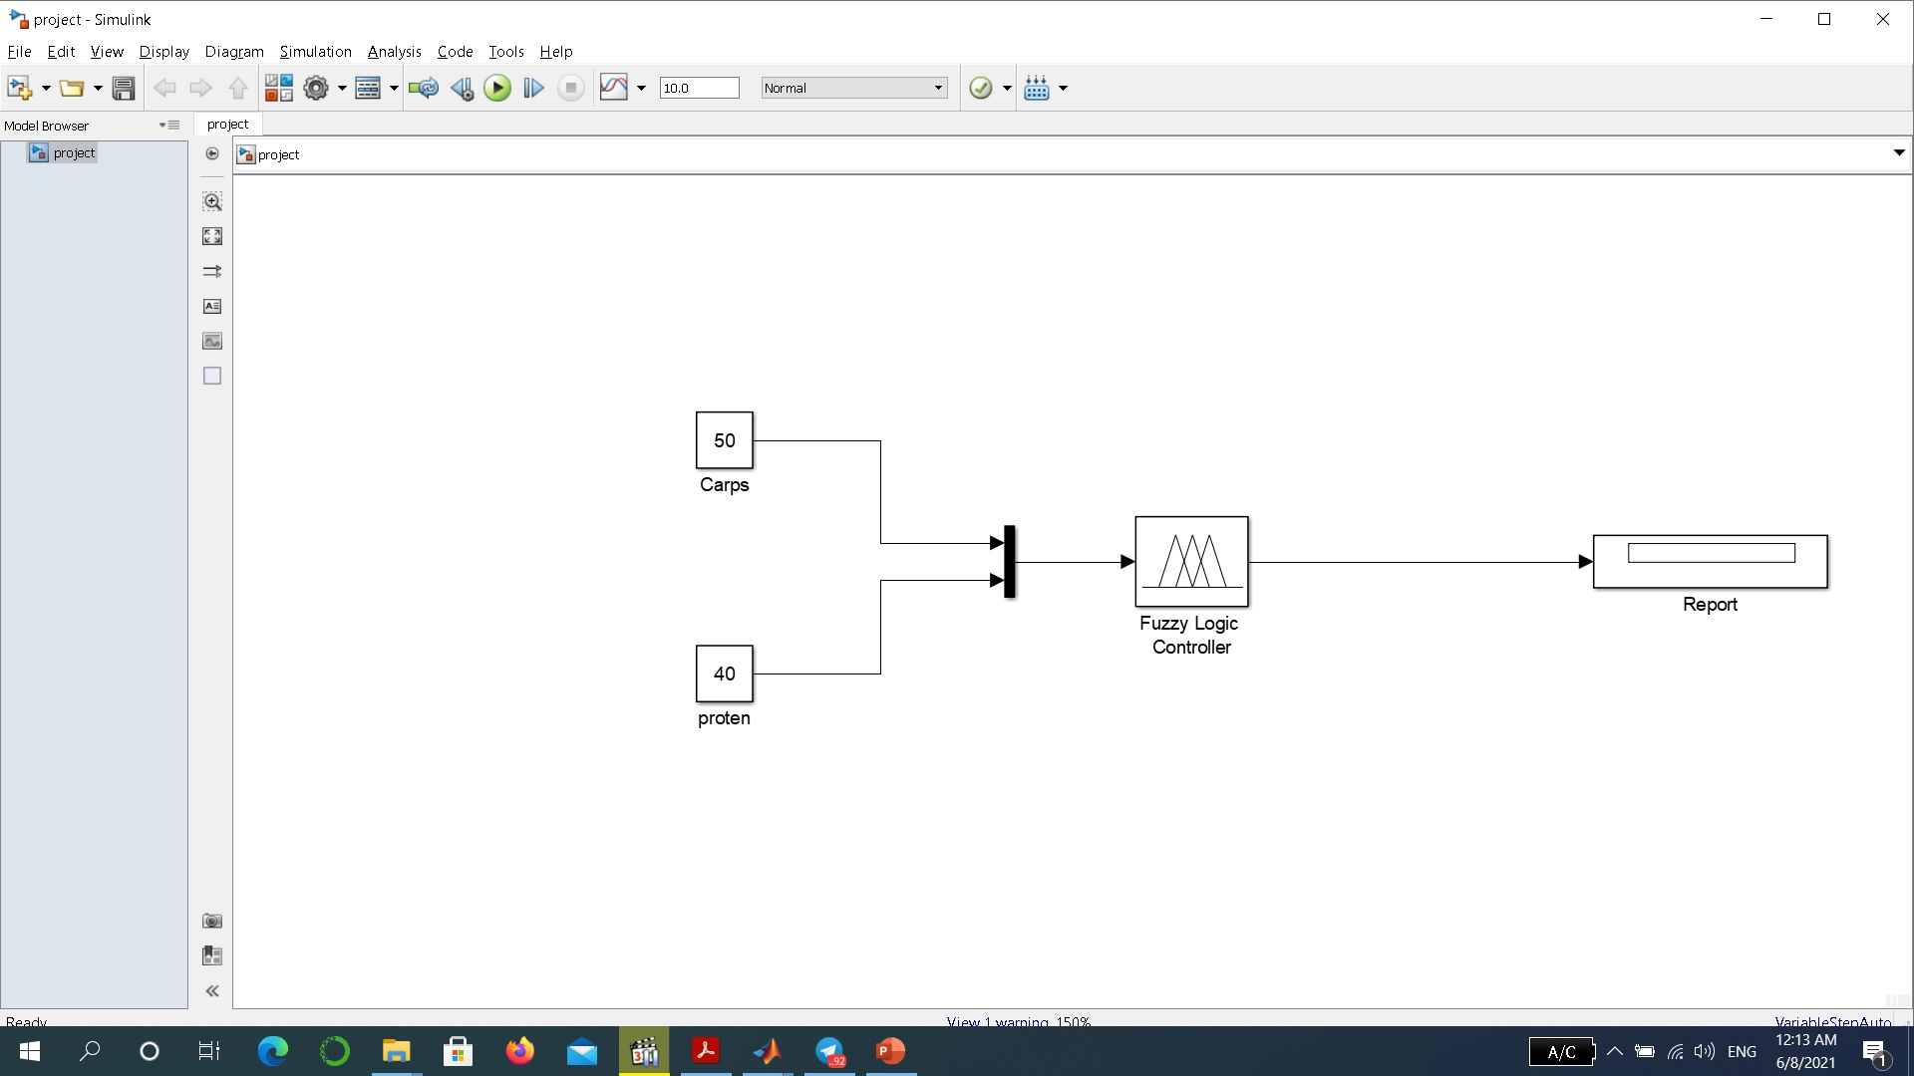
Simulink of project with 2 input and 1 output:

